Slide 1

Programming
Zeynep Orhan
orhanz@union.edu

Slide 2
Dear Computer, Why Don’t You Understand Me?
Merhaba
İsmim Zeynep Orhan
Bugün programlama hakkında konuşacağım
Merhaba / HELLO
İsmim Zeynep Orhan / MY NAME IS ZEYNEP ORHAN
Bugün programlama hakkında konuşacağım / TODAY I WILL TALK ABOUT PROGRAMMING
Image:http://gph.is/1TMBM7y
Confused? Don’t worry!!!
I will continue in English

Slide 3

Dear Computer, Why Don’t You Understand Me?

Slide 4

Expectations
Computers would be a lot more useful if they could understand and talk to us
But they are fazed by natural human language.
How can we help the computers learn the language as kids do?
Is it easy or possible?
Definitely not easy, but it is possible at least to some extent, since this task has its own challenges!
I have a final tomorrow and don’t know anything. Can you help me?
NO WAY!!!

Slide 5


Slide 6
eureka!
Algorithm: A set of instructions describing how to do a task (or process).
Programming: C

Slide 7
Hardware Components of a Typical Computer
Input/Output
Devices
Central
Processing
Unit
Memory
"Buses" allow components to pass data to each other.

Slide 8
Hardware Components of a Typical Computer
Input/Output
Devices
Central
Processing
Unit
Memory
I/O Devices (Peripherals) - to communicate with the outside world.
Examples:
Input: keyboard, mouse, microphone, scanner, sensors (camera, infra-red), punch-cards, "mark sense" cards.
Output: video, printer, audio speakers, etc.
Notes:
Electrographic is a term used for punched card and page scanning technology that allowed cards or pages marked with a pencil to be processed or converted into punched cards. That technology was sold by IBM, its developer, under the term mark sense. A "mark sense pencil lead" sold by IBM would meet federal specifications for "electrographic lead."
Mark sense was a trade name used by IBM for electrographic forms and systems. It has since come to be used as a generic term for any technology allowing marks made using ordinary writing implements to be processed, encompassing both optical mark recognition and electrographic technology, because the user of a mark-sense form cannot generally tell if the marks are sensed electrically or optically. The term "mark sense" is not generally used when referring to technology that distinguishes the shape of the mark; the general term optical character recognition is generally used when mark shapes are distinguished. Because the term mark-sense was originally a trade name, the Federal Government generally used the term electrographic.
In the 1940s, 50s, and 60s, mark sense technology was widely used for applications like recording meter readings and recording long distance telephone calls. Many thousands of pencils were made expressly for mark sense applications by the Dur-O-Lite Pencil Company and by the Autopoint Company. Many of the pencils made for the "Bell System" were stamped "MARK SENSE LEAD" and for the Federal Government, "US Government Electrographic."
In the early 1930s, science teacher Reynold B. Johnson developed an automatic test scoring machine. IBM bought Johnson's invention and hired him as an engineer - the machine was sold as the IBM 805 Test Scoring Machine. The first large-scale use of the IBM 805 was by the American Council on Education's Cooperative Test Service in 1936; in 1947, the Cooperative Test Service became part of the Educational Testing Service. Johnson went on to develop a range of electrographic mark-sense machinery.
Various IBM equipment could be used with mark sense cards including the IBM 513 and IBM 514 Reproducing Punches, the IBM 557 Alphabetic Interpreter, and the IBM 519 Electric Document Originating Machine.
https://en.wikipedia.org/wiki/Mark_sense

Slide 9
Other Input/Output Devices
The computer stores information for longer periods of time as files in secondary (mass) storage devices.
Examples: Hard drive, Floppy disk, Tape, Cassette, CD-ROM (Compact Disk Read-Only Memory), Flopticals, Cartridges, etc.
Communications device
Examples: Modems, Ethernet cards

Slide 10
Hardware Components of a Typical Computer
Input/Output
Devices
Central
Processing
Unit
Memory
Central Processing Unit (CPU) - performs the basic operations.
consists of two parts:
Arithmetic / Logic Unit (ALU) - data manipulation
Control Unit - coordinate machine’s activities

Slide 11
Hardware Components of a Typical Computer
Input/Output
Devices
Central
Processing
Unit
Memory
Main Memory - holds programs and data
stores bits in fixed-sized chunks: “word” (8, 16, 32, or 64 bits)
each word is stored in a cell, which has a unique address
the cells can be accessed in any order (thus, random-access memory or “RAM”

Slide 12
"Bits, Bytes, Kilo-, Mega-, Giga-, …"
A bit: 0 or 1
A word: chunk of bits (8, 16, 32 or 64 bits)
a byte = 8 bits
a kilobyte = 2¹⁰ bytes = 1024 bytes
a megabyte = 1024 KB = 2²⁰ bytes = 1,048,576 bytes
a gigabyte = 1024 MB = 2³⁰ bytes
a terabyte = 1024 GB = 2⁴⁰ bytes

Slide 13
Topics
Solving problems
Algorithms
Values and variables

Slide 14
How do we solve problems?
We "just do"
Guesswork-and-luck
Trial-and-error
Experience (possibly someone else's)
"Scientifically"

Slide 15
The Problem-solving Process
"Doctor, my head hurts"
Patient has elevated pressure in anterior parietal lobe.
Analysis
Problem specification
Design
1. Sterilize cranial saw
2. Anaesthetize patient
3. Remove top of skull
4. Get the big spoon...
5. etc., etc.
Algorithm
Implementation
sterilize(saw,alcohol);
raise_hammer();
lower hammer(fast);
start(saw);
/* etc. etc. */
Program
Compilation
010011101011001010101010100101010101010011001010101010100101101001110101010101001001011101001111010101011111010101000110100001101...
Executable (solution)

Slide 16
Algorithm
A sequence of instructions specifying the steps required to accomplish some task
Named after: Muhammad ibn Musa al-Khwarizmi
of Khowarezm (now Khiva in Uzbekistan)
Notes:
Al-Khwārizmī's contributions to mathematics, geography, astronomy, and cartography established the basis for innovation in algebra and trigonometry. His systematic approach to solving linear and quadratic equations led to algebra, a word derived from the title of his book on the subject, "The Compendious Book on Calculation by Completion and Balancing".
On the Calculation with Hindu Numerals written about 820, was principally responsible for spreading the Hindu–Arabic numeral system throughout the Middle East and Europe. It was translated into Latin as Algoritmi de numero Indorum. Al-Khwārizmī, rendered as (Latin) Algoritmi, led to the term "algorithm".
Some of his work was based on Persian and Babylonian astronomy, Indian numbers, and Greek mathematics.

Slide 17
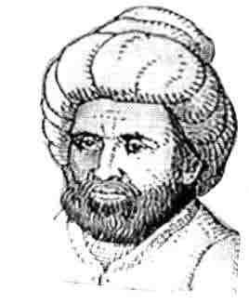
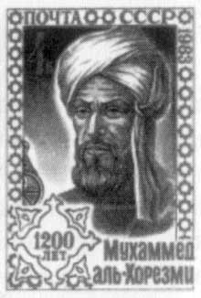
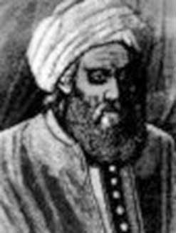
Algorithm– History
Muhammad ibn Musa Al-Khwarizmi
Circa 160-230 A.H. (anno Hegirae)
in the year of the Hegira; of the Muslim era
Circa 780-850 C.E. (Common Era)

Slide 18
Algorithm – Working Definition
A sequence of instructions describing how to do a task
[As opposed to actually executing
the instructions]

Slide 19
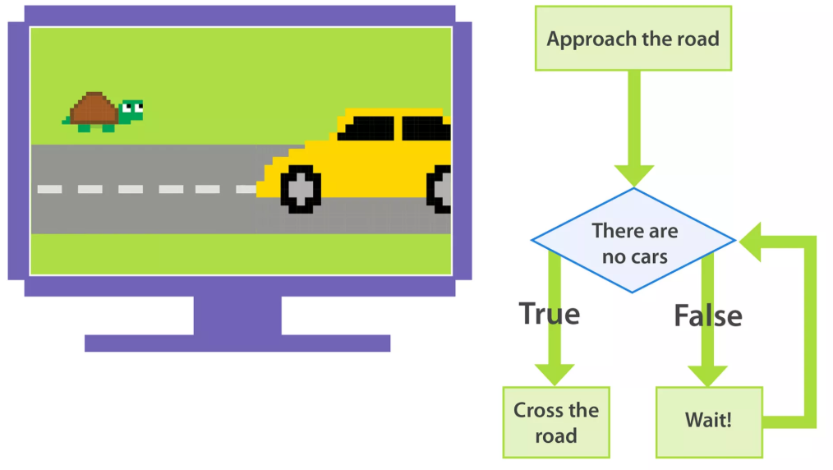
Algorithm -- Examples
A cooking recipe
Assembly instructions for a model
The rules of how to play a game
Description of a martial arts technique
Directions for driving from A to B
A knitting pattern
A car repair manual

Slide 20
From Algorithms to Programs
Problem
Algorithm: A sequence of instructions describing how to do a task (or process)
Program

Slide 21
Components of an Algorithm
Variables and values
Instructions
Sequences
Procedures
Selections
Repetitions
Documentation

Slide 22
Values
Represent quantities, amounts or measurements
May be numerical or alphabetical (or other things)
Often have a unit related to their purpose
Example:
Recipe ingredients

Slide 23

Variables
Are containers for values – places to store values
Example:
Variable
Values
10 cookies
50 grams of sugar
3 slices of cake
etc.
This jar
can contain

Slide 24


Restrictions on Variables
Variables may be restricted to contain a specific type of value

Slide 25
Instructions – Examples
Directions to perform specific actions on values and variables.
Take off your shoes
Count to 10
Cut along dotted line

Slide 26
Sequence -- Example
1. Open freezer door
2. Take out Gourmet Meal™
3. Close freezer door
4. Open microwave door
5. Put Gourmet Meal™ on carousel
6. Shut microwave door
7. Set microwave on high for 5 minutes
8. Start microwave
9. Wait 5 minutes
10. Open microwave door
11. Remove Gourmet Meal™
12. Close microwave door

Slide 27
Components of an Algorithm
Values and Variables
Instruction (a.k.a. primitives)
Sequence (of instructions)
Procedure (involving instructions)
Selection (between instructions)
Repetition (of instructions)
Documentation (beside instructions)

Slide 28
Procedure
A named sequence of instructions
So that you can
Refer to it collectively (by name)
...instead of individually (by each instruction in the sequence)
Example:
Drive_To_Uni

Slide 29
Procedure -- Example
procedure Drive_To_Uni
{
1. find car keys
2. disable car alarm
3. open car door
4. get in car
5. shut car door
6. put keys in ignition
7. start car
8. back car out of driveway
9. drive to end of street
10. turn right
11. drive to end of street
12. turn left
...etc...etc...etc
...etc...etc...etc...
52. find parking space
53. pull into parking space
54. turn off engine
55. remove keys from ignition
56. open car door
57. get out
58. shut car door
59. lock car door
60. enable alarm
}

Slide 30
Procedure – Example (cont)
procedure Do_Tuesday
{
Wake_up
Have_Shower
Eat_Breakfast
Drive_To_Uni
Attend_Programming_Lecture
...etc...etc...etc...
Drive_From_Uni
...etc...etc...etc...
}
procedure Do_Week
{
Do_Monday
Do_Tuesday
Do_Wednesday
Do_Thursday
...etc...etc...etc...
}

Slide 31
Procedure
A procedure may have a set of parameters
procedure customerService ( myName, timeOfDay )
{
say “Good timeOfDay”
say “My name is myName”
say “How can I help you?”
}
customerService ( “Zeynep”, “Morning” )
customerService (“Mary”, “Afternoon” )
customerService ( “Joseph”, “Afternoon” )

Slide 32
Procedure – Example (cont)
procedure Do_Tuesday
{
Wake_up
Have_Shower
Eat_Breakfast
Drive_To_Uni
Attend_Programming_Lecture ...etc...etc...etc...
Drive_From_Uni
...etc...etc...etc...
}
An instruction invoking a procedure is known as a “procedure call”

Slide 33
Procedure – Example (cont)
procedure Do_Tuesday
{
Wake_up
Have_Shower
Eat_Breakfast
Drive_To_Uni
Attend_Programming_Lecture
...etc...etc...etc...
Drive_From_Uni
...etc...etc...etc...
}
We use brackets/curly braces to mark the beginning and end of a sequence. Some languages use this, but some not

Slide 34
Procedure – Example (cont)
procedure Do_Tuesday
{
Wake_up
Have_Shower
Eat_Breakfast
Drive_To_Uni
Attend_Programming_Lecture
...etc...etc...etc...
Drive_From_Uni
...etc...etc...etc...
}
In this subject, we also use the following words to refer to a “Procedure” :
Sub-routine
Module
Function

Slide 35
Components of an Algorithm
Values and Variables
Instruction (a.k.a. primitives)
Sequence (of instructions)
Procedure (involving instructions)
Selection (between instructions)
Repetition (of instructions)
Documentation (beside instructions)

Slide 36
Selection
An instruction that decides which of two possible sequences is executed
The decision is based on a single true/false condition
Examples:
Car repair

Slide 37
Selection Example -- Car Repair
if (motor turns)
then
{
CheckFuel
CheckSparkPlugs
CheckCarburettor
}
else
{
CheckDistributor
CheckIgnitionCoil
}

Slide 38
Selection Example – Car Repair (cont)
if (motor turns)
then
{
CheckFuel
CheckSparkPlugs
CheckCarburettor
}
else
{
CheckDistributor
CheckIgnitionCoil
}
Should be a true or false condition.

Slide 39
Selection Example -- Car Repair (cont)
if (motor turns)
then
{
CheckFuel
CheckSparkPlugs
CheckCarburettor
}
else
{
CheckDistributor
CheckIgnitionCoil
}
Sequence if the condition is true.

Slide 40
Selection Example -- Car Repair (cont)
if (motor turns)
then
{
CheckFuel
CheckSparkPlugs
CheckCarburettor
}
else
{
CheckDistributor
CheckIgnitionCoil
}
Sequence if the condition is false.

Slide 41
Selection – Several Conditions
What if several conditions need to be satisfied?
if ( today is Tuesday and the time is 11.00am )
then
{
Go to Programming Lecture
}
else
{
Go to Library
}
Solution 1

Slide 42
Selection – Several Conditions (cont)
if ( today is Tuesday )
then
{
if ( the time is 11.00am )
then
{
Go to Programming lecture
}
}
else
...etc...etc...etc...
Often called a “nested selection”
Solution 2

Slide 43
Selection – At Least One of Several Conditions
What if at least one of several conditions needs to be satisfied?
if ( I feel hungry or the time is 1.00 pm or my mate has his eye on my lunch )
then
{
Eat my lunch now
}

Slide 44
Selection – Several Courses of Action
What if there are several courses of action?
if ( button pressed is 1 )
then
{
CheckAccountBalance
}
else
{
if ( button pressed is 2 )
then
{
TransferFunds
}
else
{
if ( button pressed is 3 )
then
{
PayBills
}
else
{
if ( button pressed is 4 )
then
{
ExitPhoneBanking
}
else
{
say “Invalid option”
}
}
}
}
Form 1

Slide 45
Selection – Several Courses of Action (cont)
if ( button pressed is 1 )
then
{
CheckAccountBalance
}
else if ( button pressed is 2 )
then
{
TransferFunds
}
else if ( button pressed is 3 )
then
{
PayBills
}
else if ( button pressed is 4 )
then
{
ExitPhoneBanking
}
else
{
say “Invalid option”
}
Form 2
“Cascaded” selection.

Slide 46
Components of an Algorithm
Values and Variables
Instruction (a.k.a. primitives)
Sequence (of instructions)
Procedure (involving instructions)
Selection (between instructions)
Repetition (of instructions)
Documentation (beside instructions)

Slide 47
Repetition
Repeat an instruction...
...while (or maybe until) some true or false condition occurs
Test the condition each time before repeating the instruction
Also known as iteration or loop
Example:
Algorithm for getting an appointment

Slide 48
Repetition -- Example
procedure AskAnAppointment ( name, time, location )
{
Phone(name)
Say("Hi", name)
Say("Wanna ask an appointment in", location, "at", time, "?")
ListenToReply ( ) start begging count at zero while (reply is "No" and begging count < 100) { Say("Oh please!")
add 1 to begging count
ListenToReply ( ) }
}

Slide 49
Repetition – Example (cont)
procedure AskAnAppointment ( name, time, location )
{
Phone(name)
Say("Hi", name)
Say("Wanna ask an appointment in", location, "at", time, "?")
ListenToReply ( ) start begging count at zero while ( reply is "No" and begging count < 100 ) { Say("Oh please!")
add 1 to begging count
ListenToReply ( )
}
}
Condition is tested before sequence

Slide 50
Repetition – Example (cont)
procedure AskAnAppointment ( name, time, location )
{
Phone(name)
Say("Hi", name)
Say("Wanna ask an appointment in", location, "at", time, "?")
ListenToReply ( ) start begging count at zero while (reply is "No" and begging count < 100) { Say("Oh please!")
add 1 to begging count
ListenToReply ( ) }
}
Sequence may not get executed at all

Slide 51
Repetition – Example (cont)
Ensure initial values of variables used in the conditions are set correctly
procedure AskAnAppointment ( name, time, location )
{
Phone(name)
Say("Hi", name)
Say("Wanna ask an appointment in", location, "at", time, "?")
ListenToReply ( ) start begging count at zero while (reply is "No" and begging count < 100) { Say("Oh please!")
add 1 to begging count ListenToReply ( )
}
}

Slide 52
Repetition – Example (cont)
procedure AskAnAppointment ( name, time, location )
{
Phone(name)
Say("Hi", name)
Say("Wanna ask an appointment in", location, "at", time, "?")
ListenToReply ( ) start begging count at zero while (reply is "No" and begging count < 100) { Say("Oh please!")
add 1 to begging count ListenToReply ( )
}
}
Ensure the variables used in the conditions are updated in each iteration

Slide 53
Repetition – Example (cont)
What if we don’t increment the begging count?
procedure AskAnAppointment ( name, time, location )
{
Phone(name)
Say("Hi", name)
Say("Wanna ask an appointment in", location, "at", time, "?")
ListenToReply ( ) start begging count at zero while (reply is "No" and begging count < 100) { Say("Oh please!")
}
}
Infinite loop

Slide 54
Repetition – Variation
decide on Time and Location
initialise booking to “unsuccessful”
while ( not successfully booked )
{
get next Name in little black book
AskAnAppointment(Name, Time, Location)
DetermineBookingSuccess
}
SighWithRelief

Slide 55
Repetition– Pre-tested Loop
decide on Time and Location
initialise booking to “unsuccessful”
while ( not successfully booked )
{
get next Name in little black book
AskAnAppointment(Name, Time, Location)
DetermineBookingSuccess
}
SighWithRelief
pre-tested loop

Slide 56
Repetition – Pre-tested Loop
decide on Time and Location
initialise booking to “unsuccessful”
until ( successfully booked )
{
get next Name in little black book
AskAnAppointment(Name, Time, Location)
DetermineBookingSuccess
}
SighWithRelief
pre-tested loop

Slide 57
Repetition – Post-tested Loop
decide on Time and Location
initialise booking to “unsuccessful”
do
{
get next Name in little black book
AskAnAppointment(Name, Time, Location)
DetermineBookingSuccess
} while ( not successfully booked )
SighWithRelief
Sequence is executed at least once
post-tested loop

Slide 58
Repetition – Post-tested Loop
decide on Time and Location
initialise booking to “unsuccessful”
repeat
{
get next Name in little black book
AskAnAppointment(Name, Time, Location)
DetermineBookingSuccess
} until ( successfully booked )
SighWithRelief

Slide 59
Repetition -- Variations
decide on Time and Location
initialise booking to “unsuccessful”
loop
{
get next Name in little black book
AskAnAppointment(Name, Time, Location)
DetermineBookingSuccess
if ( successfully booked )
then
{
break loop
}
}
SighWithRelief

Slide 60
Components of an Algorithm
Values and Variables
Instruction (a.k.a. primitives)
Sequence (of instructions)
Procedure (involving instructions)
Selection (between instructions)
Repetition (of instructions)
Documentation (beside instructions)

Slide 61
Documentation
Records what the algorithm does
Describes how it does it
Explains the purpose of each component of the algorithm
Notes restrictions or expectations
Example:
Getting a Appointment (again)

Slide 62
Documentation -- Example
Think of something to do
decide on time and location
Work through address book to look for a person
initialise booking to “unsuccessful”
until (successfully booked)
{
get next Name in little black book
AskAnAppointment(Name, Time, Location)
DetermineBookingSuccess
}
Assumes that I will find someone in the book before it runs out
SighWithRelief

Slide 63
The Software Development Process
Define the problem clearly
Analyse the problem thoroughly
Design an algorithm carefully
Code the algorithm efficiently
Test the code thoroughly
Document the system lucidly

Slide 64
Top-down Algorithm Design
Write down what you have to do
Break that into 3-7 smaller steps
Break each step into 3-7 smaller steps
Keeping subdividing until each individual step is easy enough to do – i.e., until it is a single instruction
Example:
Learning

Slide 65
Top-down Design -- Example
Read lecture notes
Read textbook
Read exercise
Design algorithm
Code solution
Test and document
Record insights
Read
Make notes
Prepare questions
Attend lecture
Listen and think
Complete practices
Attend tute
Record answers to questions
Revise notes
Prepare
Study
Reinforce
Learn

Slide 66
Summary
Problem Solving Process
Algorithms
Components of Algorithms

Slide 67
From Algorithms to Programs
Both are sets of instructions on how to do a task
Algorithm:
talking to humans, easy to understand
in plain (English) language
Program:
talking to computer (compiler)
can be regarded as a “formal expression” of an algorithm

Slide 68
What is a program?
A program is a way of solving some problem-a set of directives (or instructions) stating how to go about achieving to some desired results
Thus program must provide a precise list of instructions
stating what you want to be done,
which someone could follow in order to achieve the task
Examples of (non computer) programs:
* a recipe
* car repair manual

Slide 69
Programming Language Terms
A computer program is a precise list of instructions, or statements, to solve a particular problem, specified in a programming language
Effectively, the computer
obey or executes the statements in the program,
creating and manipulating objects,
following the algorithm expressed in the program
It is useful to have some idea of what is going on “behind the scenes” in getting a program to execute

Slide 70
How does a program get executed?
The programs you write are expressed in a programming language and stored in the computer as a sequence of printable characters in a file-called the source file
In this source form, the program cannot be directly executed by the computer
The “language” and instructions that the computer understands and obeys are very different:
* expressed as sequences of binary digits/bits (0’s and 1’s)
* very low-level and general purpose
Source file has to be translated into a form that the computer can execute

Slide 71
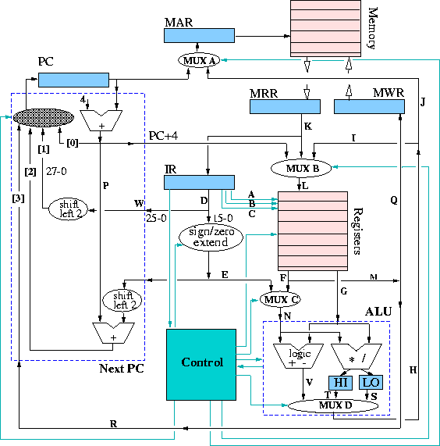
Machine Language
10100110 01110110
00100110 00000000
11111010 11111010
01001110 10100110
11100110 10010110
11001110 00101110
10100110 01001110
11111010 01100110
01001110 10000110
etc...

Slide 72
High-Level Language
10100110 01110110
00100110 00000000
11111010 11111010
01001110 10100110
11100110 10010110
11001110 00101110
10100110 01001110
11111010 01100110
01001110 10000110
etc...
#include <stdio.h>
int main()
{
printf(“Hello”);
return 0;
}
Source code
Executable code
Compilers and linkers translate a high level program into executable machine code.

Slide 73


Slide 74

That’s all!!
Thanks for listening
Any questions?
(Questions will be answered by a HUMAN!!!)

